Slide 1
MyID90
Thomas Bioren, Carson Holscher, Chris Kim

Slide 2
What's our Problem?

Slide 3
Booking ID90 Flights
90% industry discount (ID90) is for airline employees on any participating airline
You can fly standby (if there’s space available) for 90% off a regular ticket
Flight loads (how full a flight is) is not publicly available via API because it’s considered confidential information
Only employees of the airline can see flight loads for their airline
People booking ID90 flights hope their flight won’t fill up when they buy a ticket
If the flight fills up, you’re out of luck

Slide 4
Current Solutions
Hope and pray
A Facebook group where you can ask employees of the airline you’re booking your flight on to check for you

Slide 5
Our Solution

Slide 6
MyID90
A database that connects airline employees to each other
Users can spend a “token” to request the load of a flight
Users can earn a “token” to fulfill a load request

Slide 7
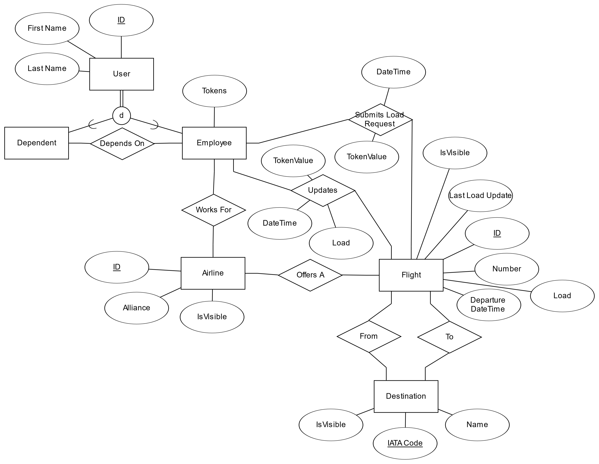
ER Diagram

Slide 8
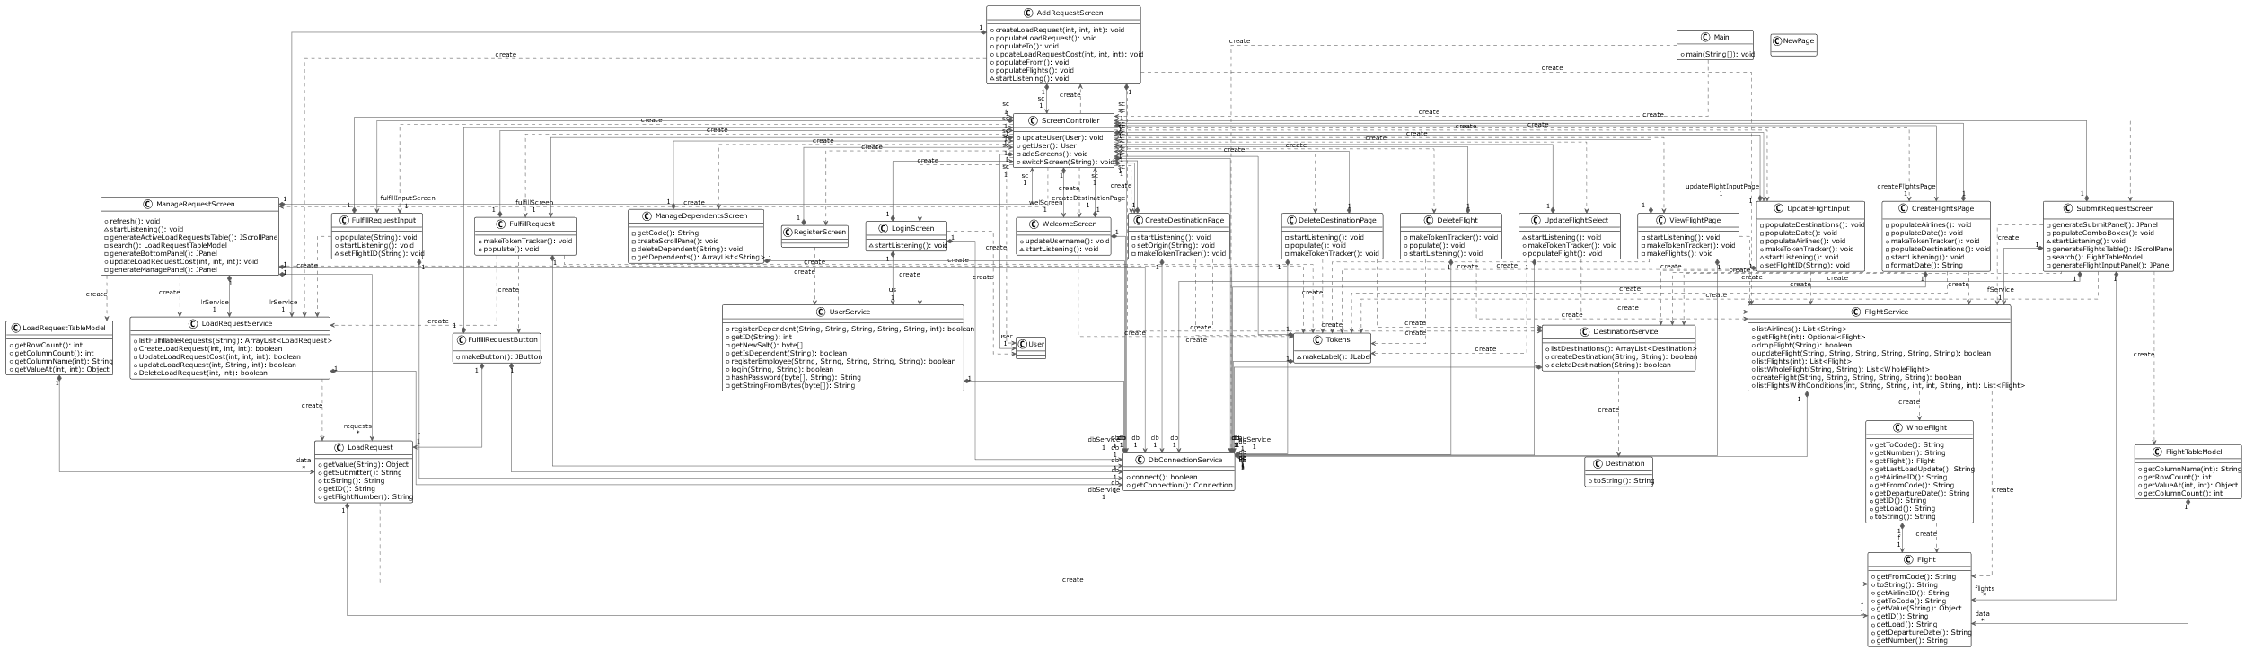
UML Diagram

Slide 9
Some Key Challenges

Slide 10
Registering Dependents
Dependents need to be able to register as an employee's dependent
You shouldn't be able to register as anybody's dependent
We created a unique "add code" that each dependent needs to enter along with the employee's username
Future plans: Create a rotating add code that uses the current time as a hash

Slide 11
UI and SQL relationship
Java UI (OOD), calls SQL stored procedures
UI features in change

Slide 12
Walkthrough

Slide 13
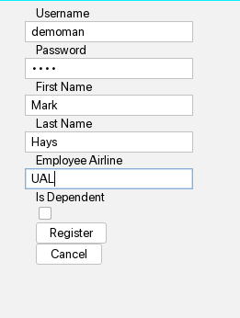
Registration & Login

Slide 14
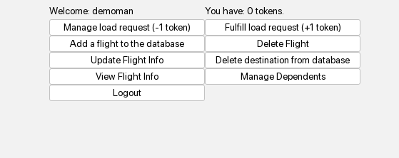
Welcome Screen

Slide 15
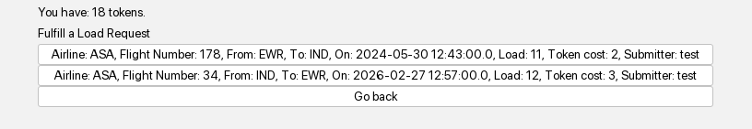
Fulfilling Load Requests

Slide 16

Fulfilling Load Requests

Slide 17
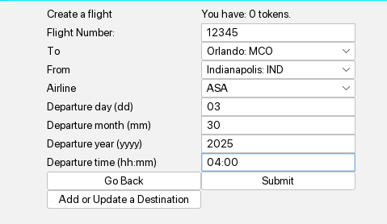
Create Flights

Slide 18
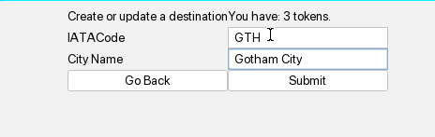
Create Destination

Slide 19
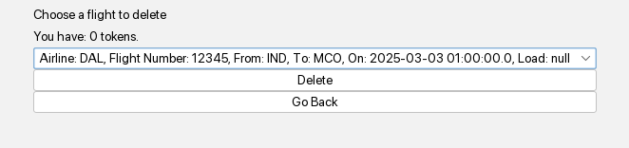
Delete Flight

Slide 20
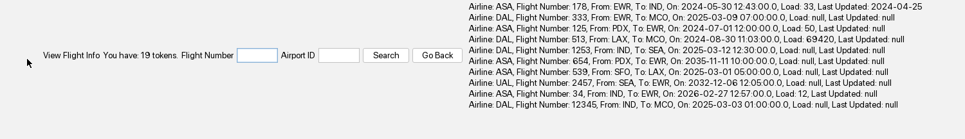
View Flight

Slide 21
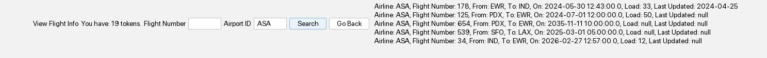
View Flight

Slide 22

View Flight

Slide 23
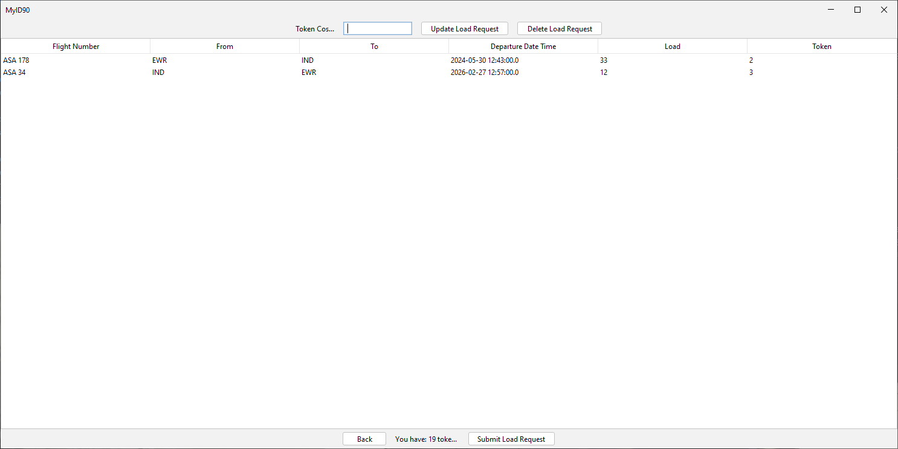
Manage Load Request

Slide 24
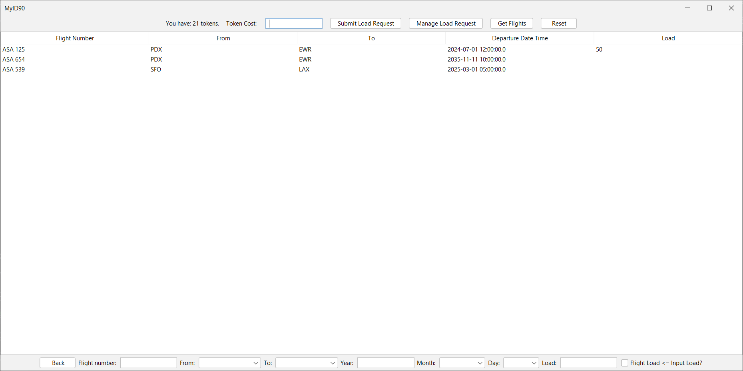
Submit Load Request

